Slide 1

Automated Detection of Blood Cancer Diagnosis with Microscopic Image Analysis and Cell Counting of ALL, AML, CLL, and CML Cells
Final Review
Batch No. : 1
Date: 18.05.2023
AZARUDDIN SHARIFF - 410619104005
MD HASAN RAJA - 410619104011
MOHAMED FASEEH - 410619104018
Mr. S. MANIMARAN
Assistant Professor
Supervisor

Slide 2

OBJECTIVE
The main objective of this project is to detect and count cancerous cells in microscopic blood smear images. The circulatory system is crucial in transporting blood throughout the body, supplying oxygen, carrying carbon dioxide, minerals, and nutrients.

Slide 3
DOMAIN DESCRIPTION
Machine learning is a subfield of artificial intelligence that focuses on enabling machines to learn from data, without being explicitly programmed. It involves developing algorithms that can learn patterns and make predictions or decisions based on data, by iteratively adjusting their parameters to minimize errors.
There are three main types of machine learning: supervised learning, unsupervised learning, and reinforcement learning.
Supervised learning involves training a machine learning model on labeled data, where the input data and corresponding output labels are provided during training. The goal is to learn a mapping between the input and output data that can be used to make predictions on new, unseen data.
Unsupervised learning involves training a machine learning model on unlabeled data, where the goal is to discover patterns or structure in the data without any specific output labels.
Reinforcement learning involves training a machine learning model to make decisions in a dynamic environment by providing rewards or punishments based on the model's actions.

Slide 4
ABSTRACT
Leukemia is a cancer that progresses in stages. The four main types of leukemia are acute lymphocytic leukemia (ALL), acute myeloid leukemia (AML), chronic lymphocytic leukemia (CLL), and chronic myeloid leukemia (CML). In the proposed automated technique for detecting leukemia, the system is designed to detect and classify all four types of leukemia.
The system works by first separating the different types of cells in the blood image, including white blood cells, red blood cells, and platelets. Then, lymphocytes are identified, and their shape and color features are extracted. These features are used to classify the cells into normal or blast using an SVM classifier.

Slide 5
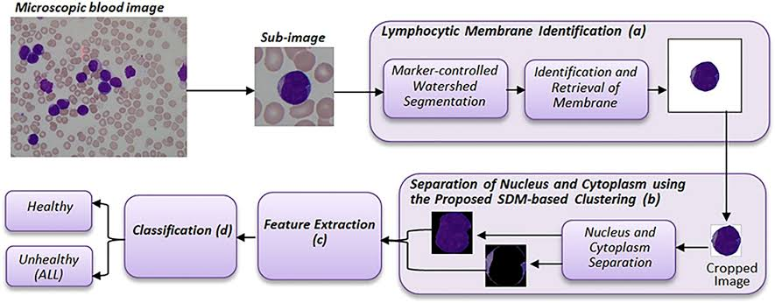
PROPOSED SYSTEM

Slide 6

ARCHITECTURE DIAGRAM

Slide 7
MODULES
1. INPUT IMAGE
2. PREPROCESSING
3. SEGMENTATION
4. FEATURE EXTRACTION
5. CLASSIFICATION

Slide 8
MODULE DESCRIPTION
INPUT IMAGE:
This means we need to read an image into the program so that we can start doing things with it. We do this using a command called "imread".
2) PREPROCESSING.
Preprocessing is a term used to describe a set of image operations that are performed at the lowest level of image abstraction.
a) RESIZING THE INPUT IMAGE
b) CONVERTING COLOR FORMAT
c) FILTERING
d) IMAGE ENHANCEMENT
e) IMAGE NORMALIZATION

Slide 9
3)SEGMENTATION
Image segmentation is a commonly used technique in digital image processing and analysis to partition an image into multiple parts or regions, often based on the characteristics of the pixels in the image.
a)Color Space Conservation
b) Morphological Operations

Slide 10
4. FEATURE EXTRACTION
In machine learning, pattern recognition and in image processing, feature extraction starts from an initial set of measured data and builds derived values (features) intended to be informative and non-redundant, facilitating the subsequent learning and generalization steps, and in some cases leading to better human interpretations.
a)Shape features
b)Color features
c)Geometrical features
d)Texture features

Slide 11
5. CLASSIFICATION:
Image classification refers to the task of extracting information classes from a multiband raster image. The resulting raster from image classification can be used to create thematic maps. The recommended way to perform classification and multivariate analysis is through the Image Classification toolbar. There are many classification algorithms are available and some classification algorithm that are given below,
a) SVM (SUPPORT VECTOR MACHINE CLASSIFICATION)

Slide 12
BLOCK DIAGRAM
Input Image
Preprocessing
segmentation
Feature extraction
classification

Slide 13
ALGORITHM EXPLAINATION
Support Vector Machine (SVM) is a machine learning algorithm that can be used for both classification and regression tasks. SVM works by finding the best possible boundary, or hyperplane, that can separate data points belonging to different classes in a dataset.
The key idea behind SVM is to find the hyperplane that maximizes the margin between the two classes. The margin is defined as the distance between the hyperplane and the closest data points from each class. The data points closest to the hyperplane are called support vectors, and they are used to determine the hyperplane.
SVM is known for its ability to handle high-dimensional data and its robustness to outliers. It is widely used in various applications such as image classification, text classification, and bioinformatics.

Slide 14
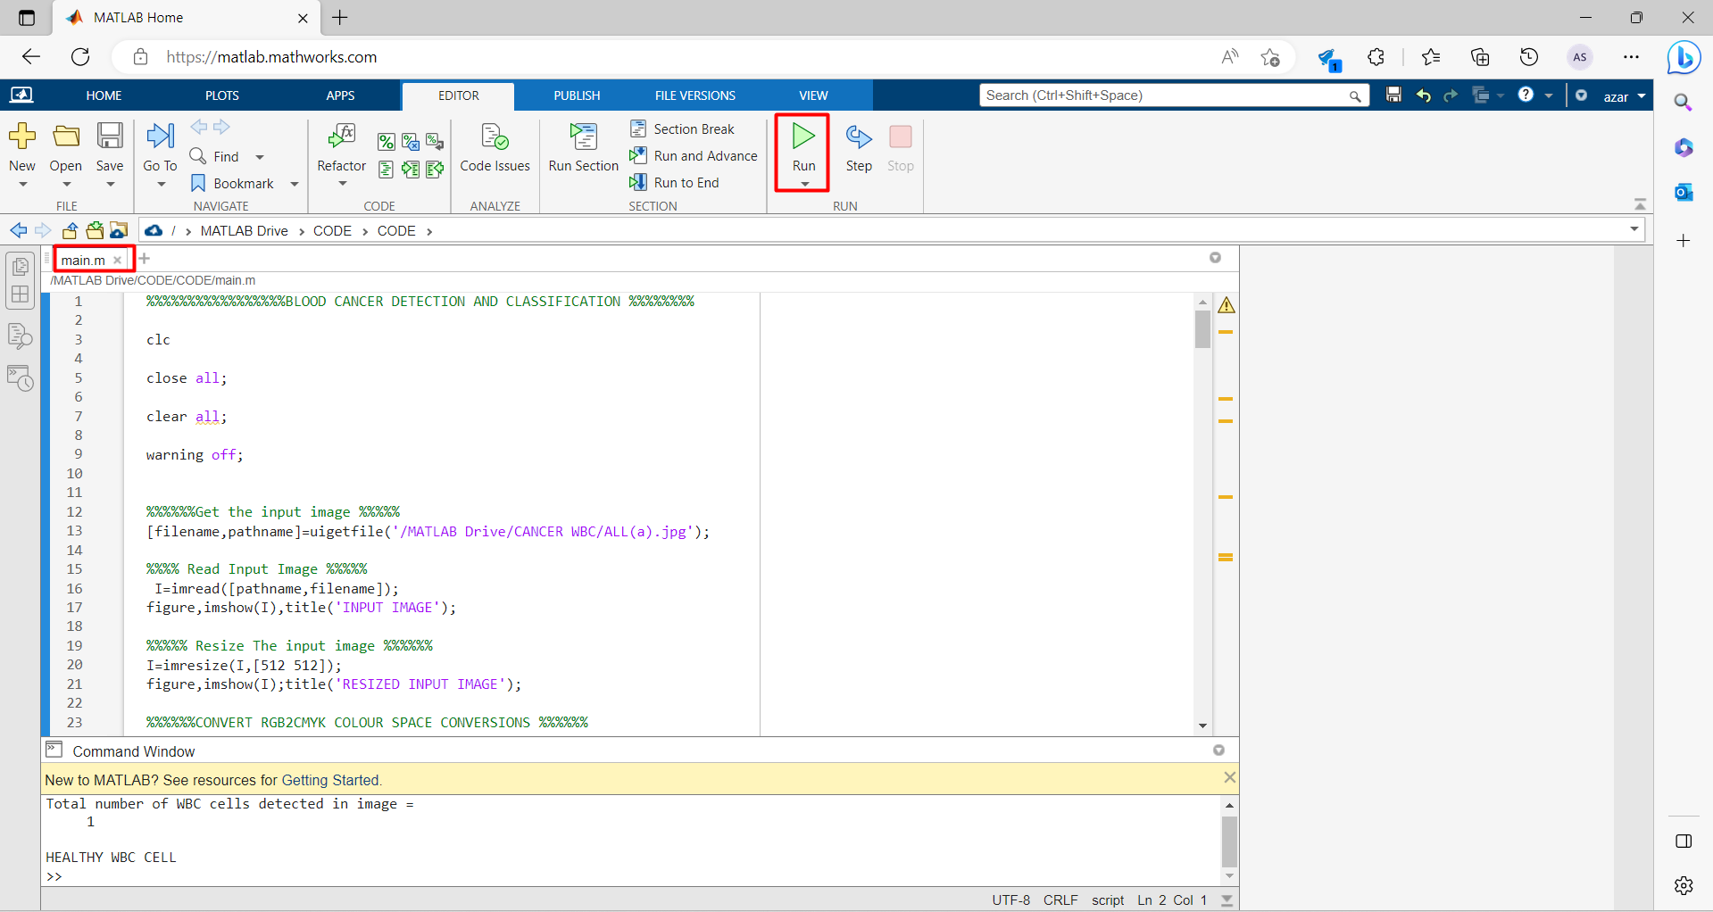
SCREENSHORTS

Slide 15
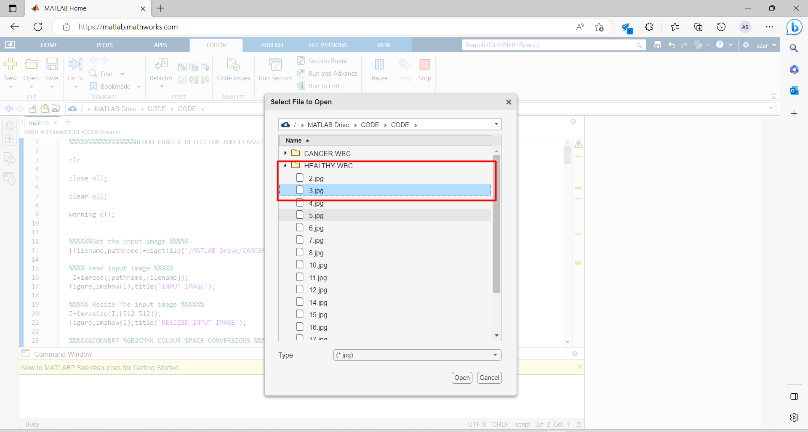

Slide 16
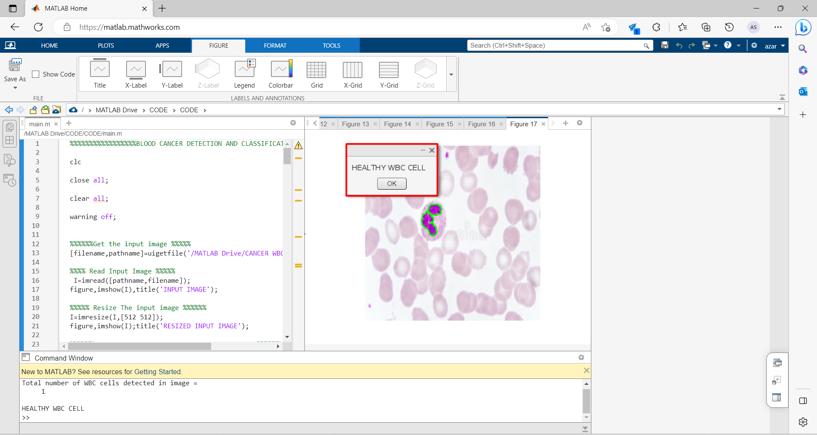

Slide 17
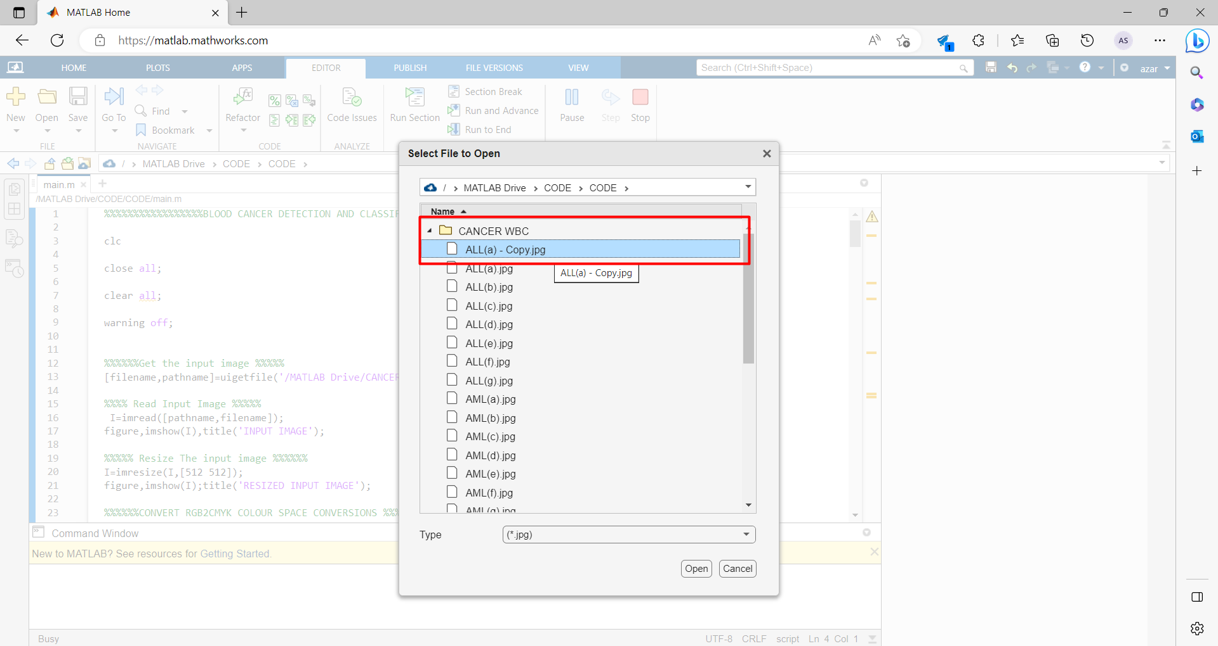

Slide 18
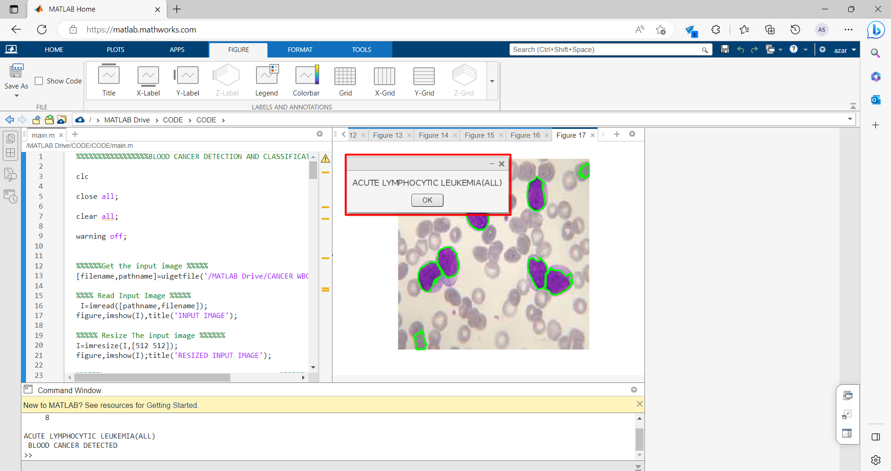

Slide 19
CONCLUSION
This paper uses image processing techniques to detect and count acute lymphoblastic leukemia from microscopic blood images. It involves cleaning up the images, separating the cells, and using a machine learning algorithm called SVM to classify normal and abnormal cells. The authors suggest that this system can be enhanced to detect other blood-related diseases.

Slide 20

DETAILS OF PUBLICATION OF PAPER

Slide 21
REFERENCES
[1] Hematology.org,’Acute Lymphocytic Leukemia: Learning Objectives’, 2017. [Online]. Available: http://www.hematology.org/Educators/Learning-Objectives/690.aspx. [Accessed: 23- may- 2018].
[2] Dana-farber.org, ’What Are the Differences Between Lymphocytic and Myelogenous Leukemia?’, 2016.[Online]. Available: https://blog.dana- farber.org/insight/2016/07/what-are-the-differences-between- lymphocytic-and-myelogenous-leukemia. [Accessed: 23- may- 2018].
[3] Curesearch.org, ’ Acute Lymphoblastic Leukemia (ALL) in Children – In Treatment’, 2010.[Online]. Available: https://curesearch.org/Acute- Lymphoblastic-Leukemia-In-Treatment. [Accessed: 28- may- 2018].
[4] Shafique, Sarmad, and Samabia Tehsin. ”Computer-Aided Diagnosis of Acute Lymphoblastic Leukaemia.” Computational and mathematical methods in medicine 2018 (2018).
[5] Karthikeyan.T, and N. Poornima. ”Micros-copic image segmentation using Fuzzy C means for leukemia diagnosis.” Leukemia 4, no. 1 (2017).

Slide 22
Thank You

